Slide 1



OPAL Tools
Free Tools for Oracle Software Development
Dietmar Aust Opal-Consulting, Cologne
www.opal-consulting.de
Notes:
I am going to tell you a story of simplicity and robustness.

Slide 2



Your Deployment Strategy?
When you move code changes (APEX, ORDS, PLSQL) from development to test and production …. What does your strategy feel like?
Notes:
When you move code changes (APEX, ORDS, PLSQL) from one development to test and production …. What does your strategy feel like?
Are you sure that you have deployed ALL of the changes? And not forgotten anything?
Are you sure that all of the depencies will install in the right order?
Are you sure that there are no compile errors / invalid objects in the end?

Slide 3
Design Goal
A person of average intelligence can do it 100% right even on a bad day.

Slide 4
Minimum Requirement
Single minimum requirement:
All changes are deployed through files!!!

Slide 5
Demo 1
JIRA-Ticket-1: Deploy a change in schema SCHEMA1
Change Package XLIB_LOGS
New column in table DUMMY

Slide 6
Demo 1
Benefits:
You don‘t have to BUILD a patch/release, it is already there
Others „build“ a patch at the end of the release cycle, you create your driving script
We put things already in the right location or copy to the destination
Connection pools are already set up, you cannot install into the „wrong“ environment

Slide 7
Demo 2
JIRA-Ticket-2: Deploy a change in schemas SCHEMA1 and SCHEMA2
Change Package XLIB_LOGS
Change APEX Application
Change ORDS Module
don‘t copy file – reference from source tree

Slide 8
Different Roles: “User“ vs „Process Designer“
Role: „Process designer“
Sets it up in the project for all developers to use
Install into git, directories can be chosen very flexibly
Define patch template
Initial export into sources
To have a starting point
Set up the local connection pools
Supports proxy connects, cloud database

Slide 9
Flexibility
Different people use different workflows
The database is the master – with or w/o version control
The file system is the master – typically with version control
A mix of the two (working alone most of the time and/or forgot to use the file). Easy synchronization would be nice.

Slide 10
Demo 3
Set up new environment

Slide 11
Design Goal
Goal? Seamless integration
Don‘t force a specific approach, rather support existing styles and improve the quality
No point in having a PERFECT approach that isn‘t widely used.
minimum requirement: Deployment through files

Slide 12
The Solution
The software:
Written in Java + (generated) batch scripts
Works on Windows, MacOS and Linux
Exporter leverages DBMS_METADATA and SQLcl
Installer leverages SQLcl (binaries already included !)
Tools can be used together … OR separately
Java application opal-export
Java application opal-install
DBMS_METADATA
SQLcl
SQLcl

Slide 13
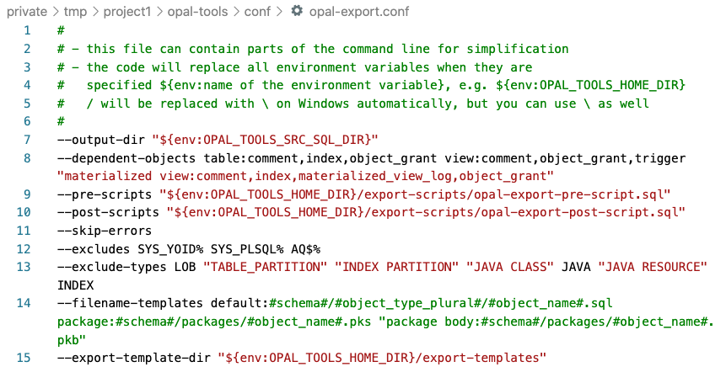
There is so much more …

Slide 14
Download / GitHub
Notes:
Drag your picture and Send to Back

Slide 15
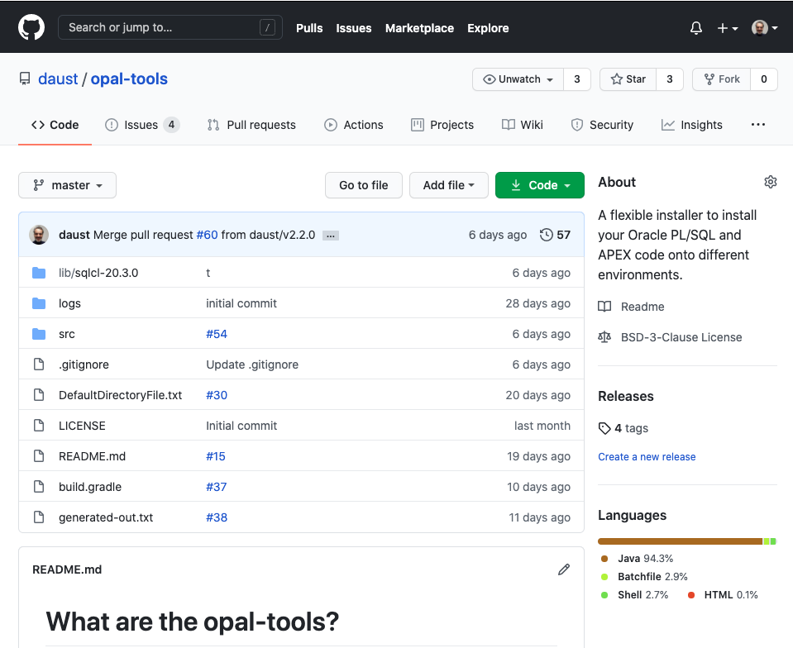
https://github.com/daust/opal-tools

Slide 16
Questions?
Opal Consulting
Email / Website
Zum Tilmeshof 11
50859 Köln
Germany
dietmar.aust@opal-consulting.de
www.opal-consulting.de

Slide 17
Artwork used
IIstudio/Bigstock.com: 391193441
sidarta/Bigstock.com: 266092933

Slide 18
Backup
Notes:
Drag your picture and Send to Back

Slide 19

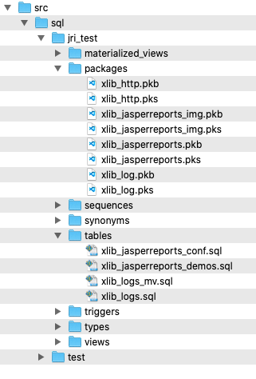
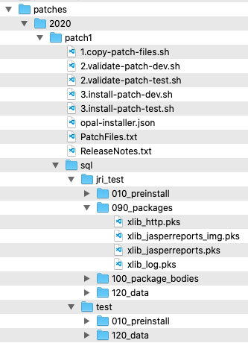
The Solution
Source Files
Patches
install
Test
Export with
DBMS_METADATA
copy files
or
reference files
e.g. @../packages/util.pks
Development
install
Export:
Database Objects
APEX applications
ORDS modules
Custom spool scripts
Patch / Deployment:
SQL scripts
Executed with SQLcl
Production
Patch Installation can be automatically registered

Slide 20
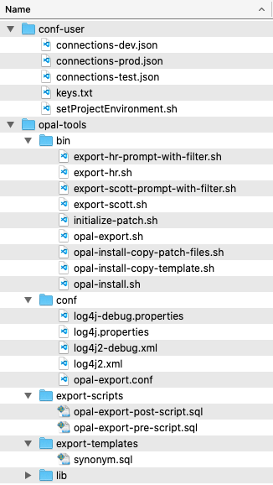
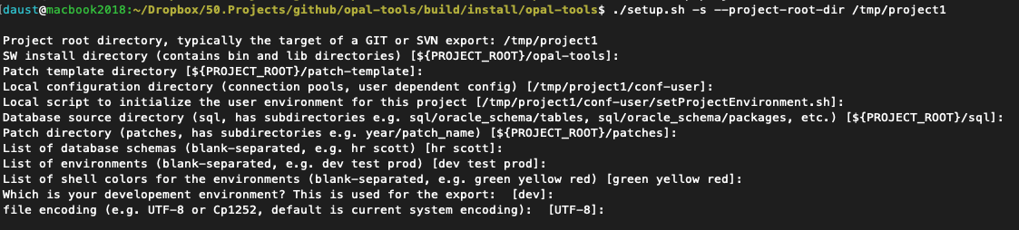
The Solution
E.g. run setup for schemas HR and SCOTT and environments dev,test,prod
Folder „conf-user“
Typically outside of GIT / SVN repository

Slide 21
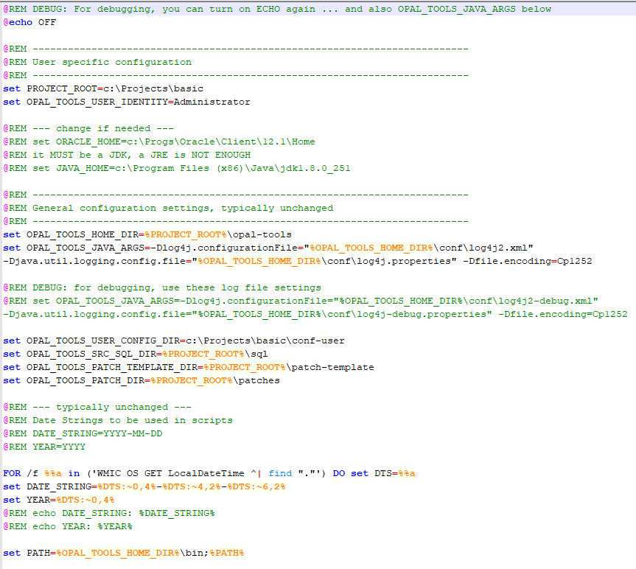
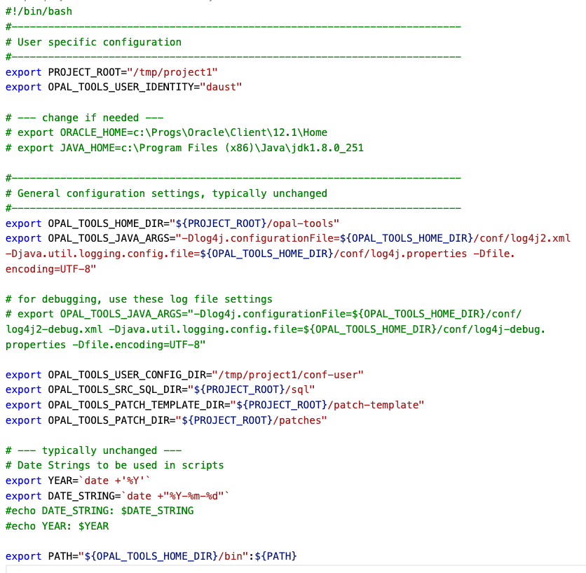
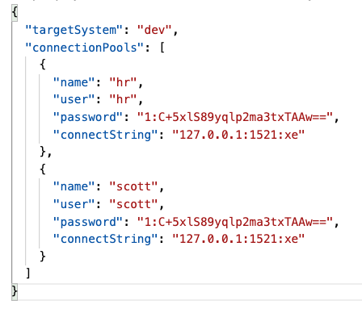
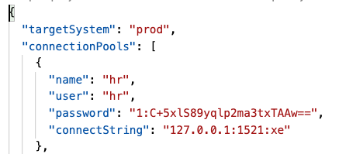
The Solution
setProjectEnvironment.sh / cmd
connections-dev.json
Support for:
Proxy Accounts
Cloud Database
connections-prod.json

Slide 22
The Solution
Folder „opal-tools/bin“
Contains scripts to call the Java programs
Contains generated scripts for each database schema

Slide 23
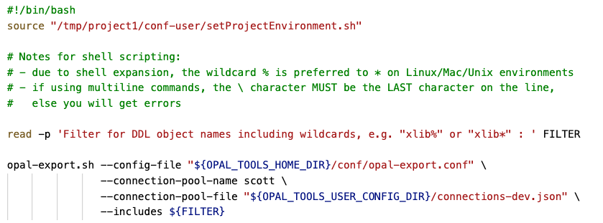
The Solution - EXPORT
opal-export.sh
simple wrapper for the Java application
export-scott-prompt-with-filter.sh
calls setProjectEnvironment.sh first
Prompts for like-filter of db objects
Uses the connection pool for the development environment

Slide 24
The Solution - EXPORT
Folder „opal-tools/conf“
Config files for the logging
Config file for global settings

Slide 25
The Solution - EXPORT
Folder „opal-tools/export-scripts“
Run before or after exporting the DDL for the selected objects

Slide 26
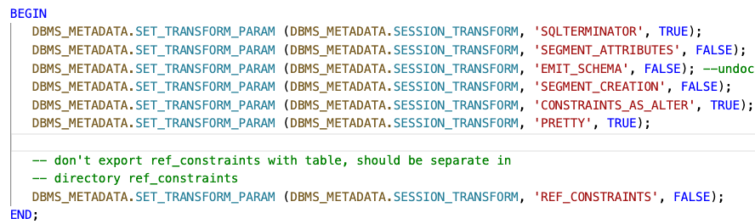
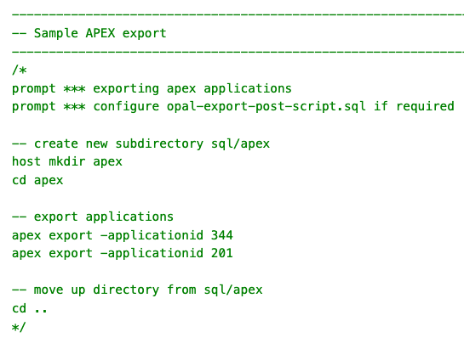
The Solution - EXPORT
opal-export-pre-script.sql
opal-export-post-script.sql

Slide 27
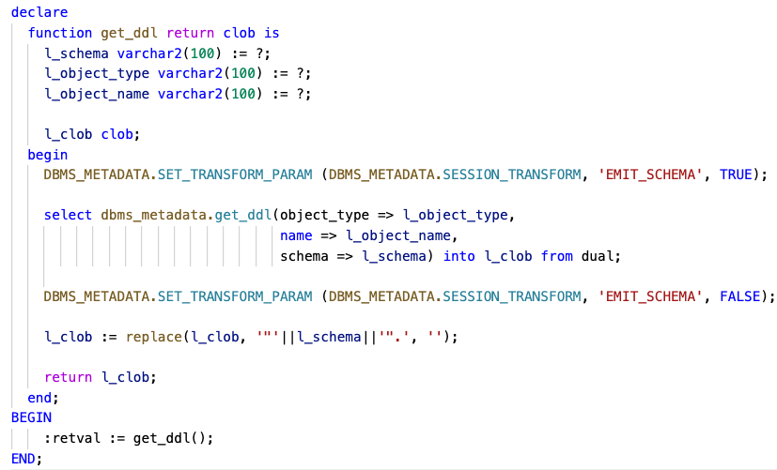
The Solution - EXPORT
Folder „opal-tools/export-templates“
Override the general call to dbms_metadata.get_ddl()

Slide 28
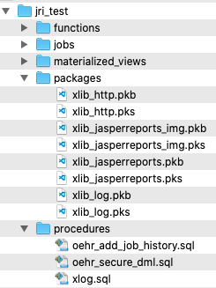
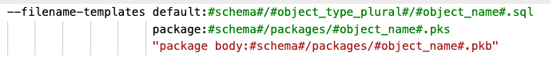
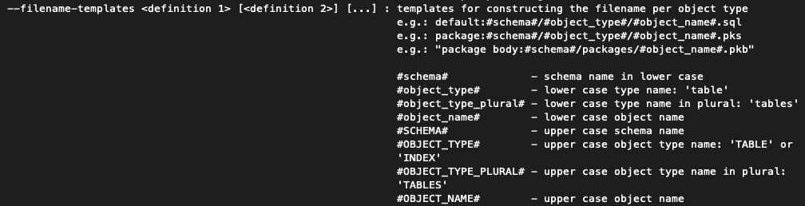
The Solution - EXPORT
Folder „sql“
Export of database object into files

Slide 29
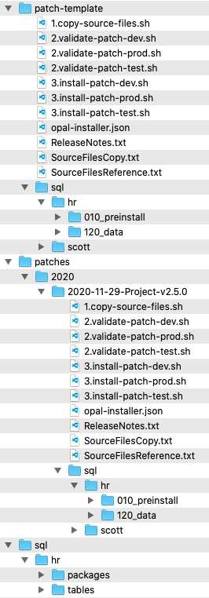
The Solution - INSTALLER
Folder „patch-template“
Will be used as a template for a new patch (copy directory and subdirectories)
Folder „sql“
sql source files
Folder „patches“
<year>/<year-month-day>-<patch name> is generated through the batch script initialize-patch.sh

Slide 30
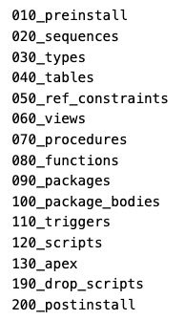
The Solution - INSTALLER
Iterate through folder tree and execute files
Connection pool is chosen based on regular expression of the file path
Scripts are organized in folders to minimize errors (dependencies / compilation)

Slide 31
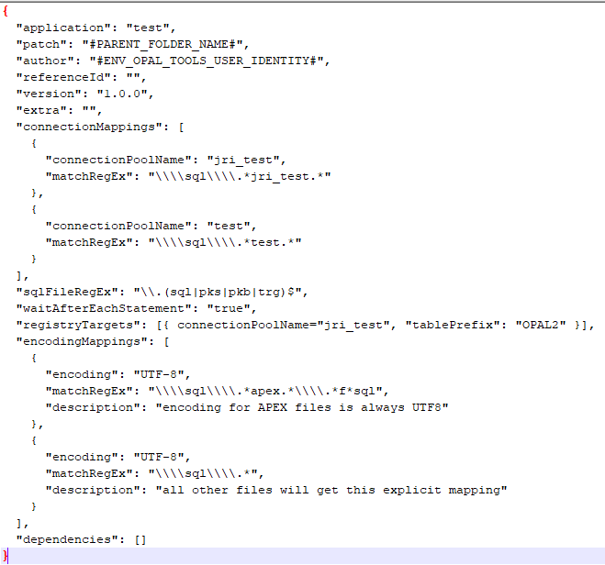
The Solution - INSTALLER
Config file for the patch: opal-installer.json

Slide 32
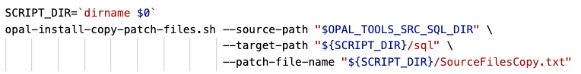
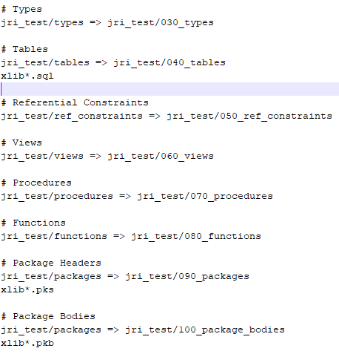
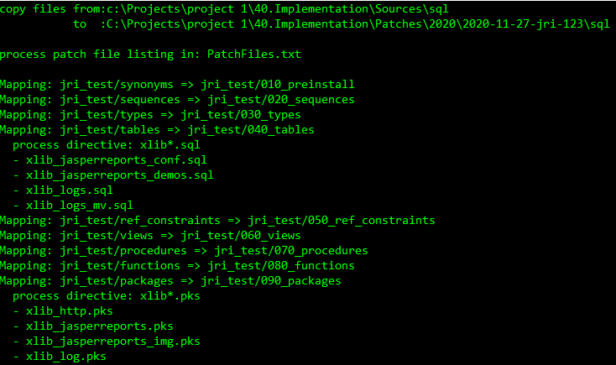
The Solution - INSTALLER
1.copy-source-files.sh
Copies files from the source tree to a target tree

Slide 33
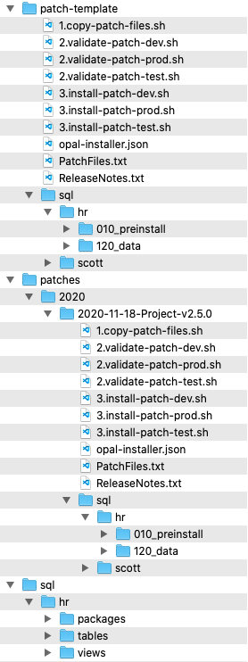
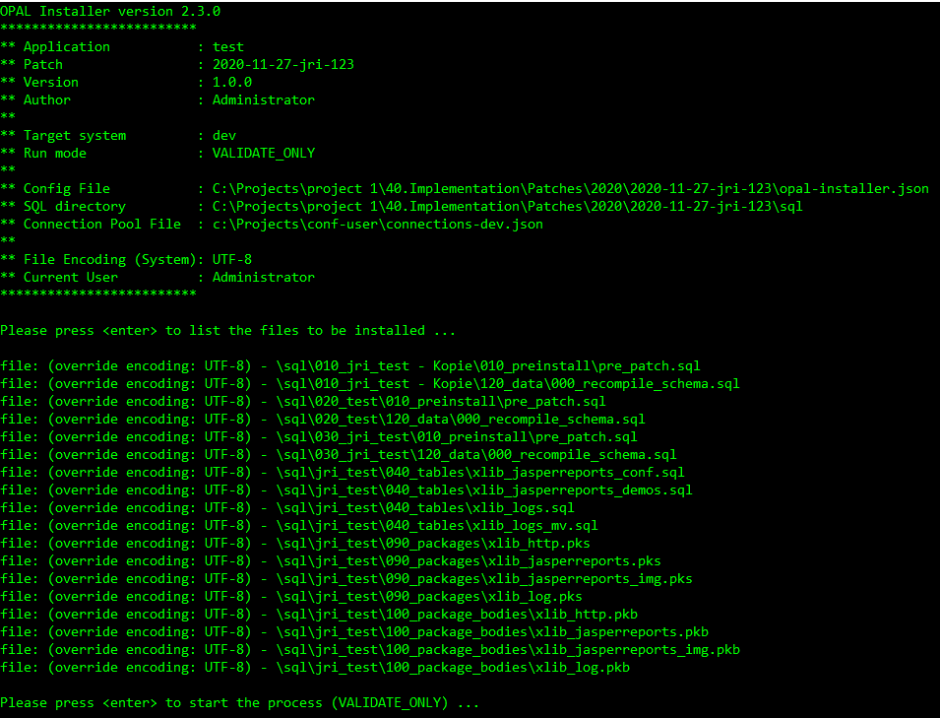
The Solution - INSTALLER
2.validate-<environment>.sh
Validates connection pool and shows files in the order they will be installed

Slide 34
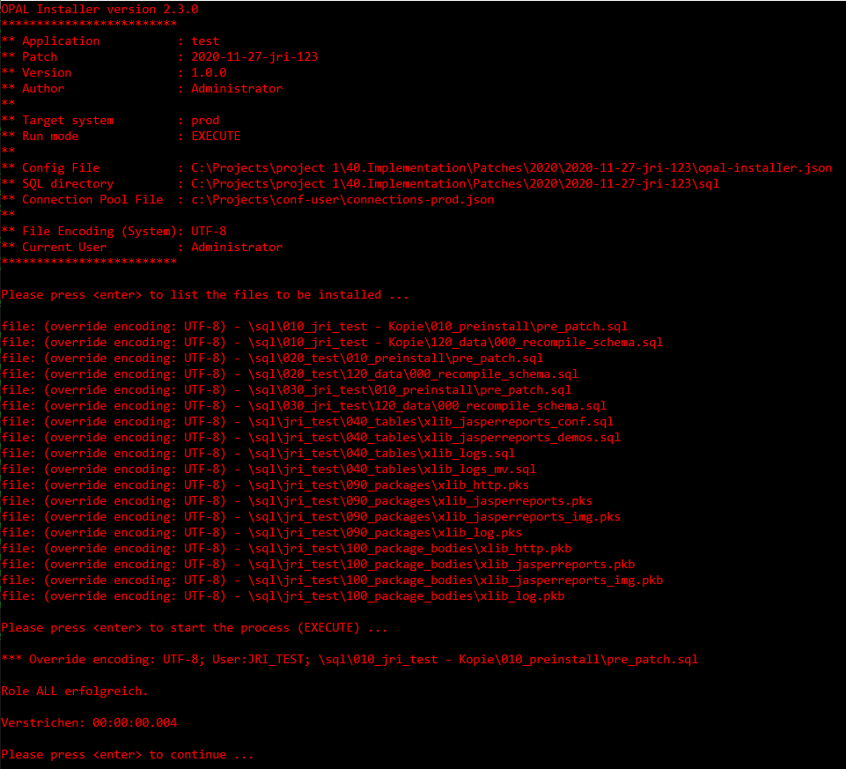
The Solution - INSTALLER
3.install-<environment>.sh

Slide 35
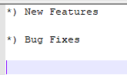
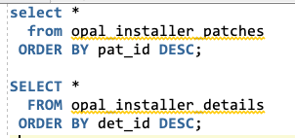
The Solution - INSTALLER
ReleaseNotes.txt
Plain text file
When it exists, will be inserted into patch table

Slide 36
Customization
Notes:
Drag your picture and Send to Back

Slide 37
Customization
EVERYTHING should be customizable
No approach is forced, no directory layout is assumed
Shell scripts are pre-generated, can and should be adapted to your needs
Patches are based on the patch-template folder, make changes there
Everything is driven by command-line switches

